Slide 1

LiDAR-based Canopy Cover prediction
July 5th Update
Alejandro Donaire Èric Sánchez Pau Ventura

Slide 2
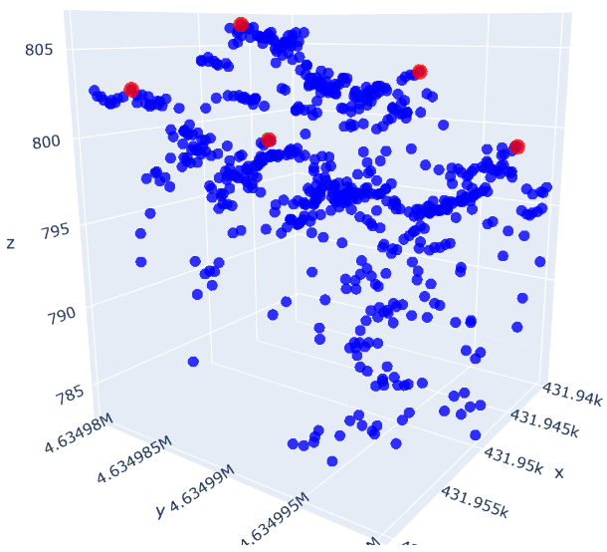
Tree-Tops algorithm completed and improved
Locates local maximums according to a radius
In a XGB model trained only with 1 block the feature ranks pretty low, which means not important
It could be more important in future models trained with more blocks

Slide 3
Cluster execution

Slide 4
Python script
Adapted the current notebook code to be executed in the cluster.
Parallel preprocessing of the blocks and training of the XGB model.
Metrics to check each part’s time and RAM usage.
Training the model with blocks multiples of 24.

Slide 5

Python script, parallel-processing approach 1

Slide 6
Python script, parallel-processing approach 2

Slide 7
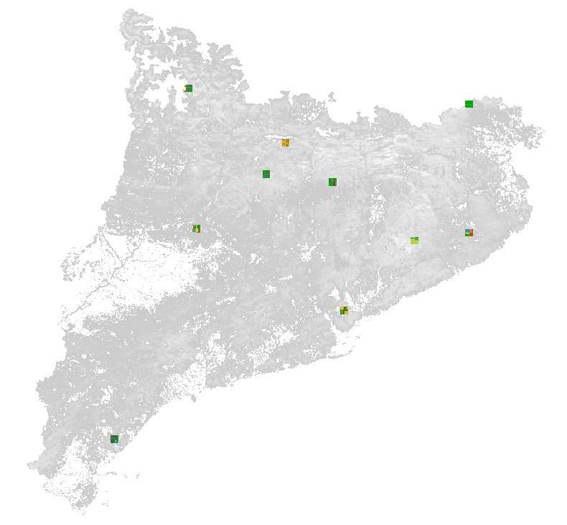
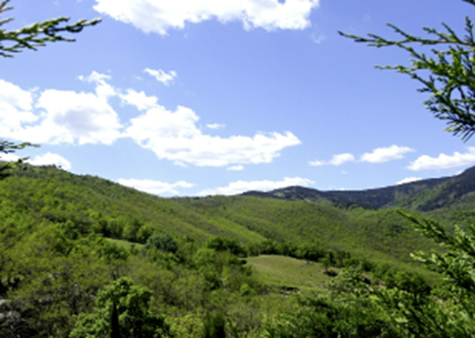
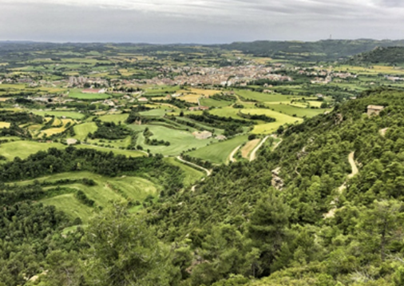
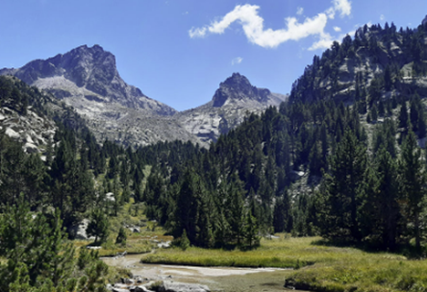
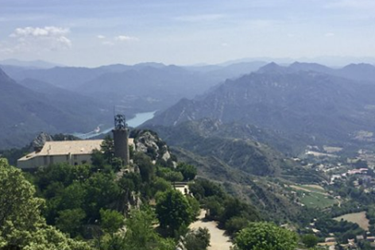
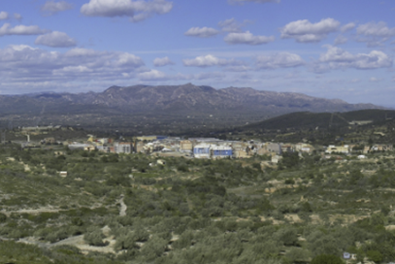
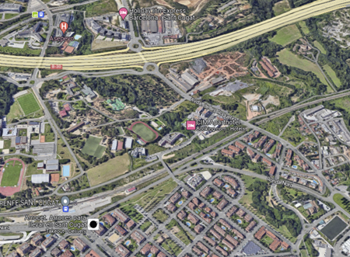
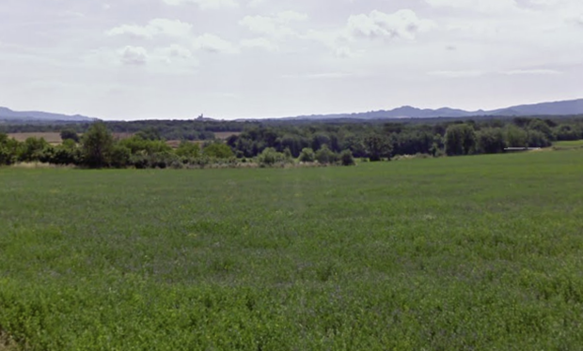
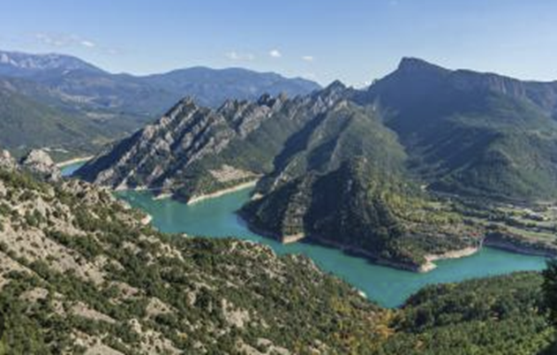
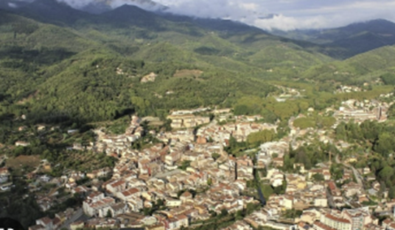
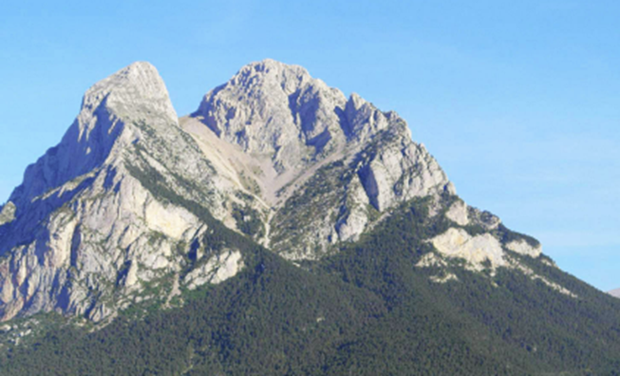
Prediction script
Allows testing the model in different environments
Uses Diverse10 Dataset
Allows Block prediction comparison

Slide 8
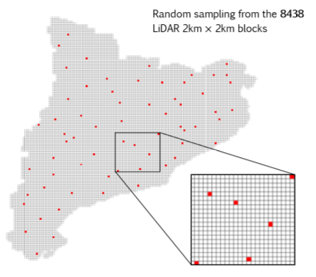
Next week
Training the model with 24*x blocks (x in 1..10) to check the scalability potential
Visualization:
Time and RAM metrics
Model performance metrics
Control blocks prediction vs real CC comparison
Finish Prediction script
Finish Training + Prediction script flowchart
Decide whether to do Feature Selection, PCA and Hyperparameter Search
Continue writing the document

